Slide 1
Routing Protocols
Link-State and Distance-Vector
Akshad Vivek Gajbhiye - 2203101
Atharva Sachin Keny - 2204219
2203107 - Ishita Partha Chail
2203119 - Mrunmayi Sandip Kulkarni

Slide 2
What is Distance-Vector?

Slide 3

Distance-Vector Routing
Ft Bellman-Ford algorithm
In these protocols, each router does not possess information about the full network topology.
It advertises its distance value (DV) calculated to other routers and receives similar advertisements from other routers unless changes are done in the local network or by neighbours (routers).

Slide 4
Information Kept by Distance Vector Router
Distance Vector Table Initialization
Distance to itself = 0
Distance to all other Router = ∞
Each Router has an ID
Associated with each link connected to a router, there is a link cost.
Intermediate hops
Distance Vector Algorithm
A router transmits its distance vector to each of its neighbors in a routing packet.
Each router receives and saves the most recently received distance vector from each of its neighbors.
A router recalculates its distance vector when: It receives a distance vector from a neighbor containing different information than before or It discovers that a link to a neighbor has gone down.
Information Kept by Distance Vector Router
When a node x receives new DV estimate from any neighbor v, it saves v’s distance vector and it updates its own DV using B-F equation:
Dx(y) = min { C(x,v) + Dv(y), Dx(y) }

Slide 5
The oldest routing protocol, and the oldest distance-vector protocol, is version 1 of the Routing Information Protocol (RIPv1). RIPv1 was formally standardized in 1988. It establishes the shortest path across a network purely on the basis of the hops, that is numbers of routers that need to be passed to reach the destination network. RIP is an interior gateway protocol, so it can be used in local area networks (LANs) on interior or border routers.
FACTS
https://en.wikipedia.org/wiki/Distance-vector_routing_protocol

Slide 6
What is Link-State?

Slide 7

Link-State Routing
Ft Dijkstra's algorithm
Global View
The basic concept of link-state routing is that every node constructs a map of the connectivity to the network, in the form of a graph, showing which nodes are connected to which other nodes.
Each node then independently calculates the next best logical path from it to every possible destination in the network. Each collection of best paths will then form each node's routing table.

Slide 8
keys to understand
the link state routing
3
Knowledge about the neighborhood: Instead of sending its routing table, a router sends the information about its neighborhood only. A router broadcast its identities and cost of the directly attached links to other routers.
Flooding: Each router sends the information to every other router on the internetwork except its neighbors. This process is known as flooding. Every router that receives the packet sends the copies to all the neighbors. Finally each and every router receives a copy of the same information.
Information Sharing: A router send the information to every other router only when the change occurs in the information.
https://www.geeksforgeeks.org/unicast-routing-link-state-routing/

Slide 9
“There are two link-state routing protocols, OSPF and IS-IS, in use. OSPF being the most popular implementation.”
Cisco Press

Slide 10
We will go in more detail of
“Link State!”
Algorithm
Flooding
Link Break
Code

Slide 11
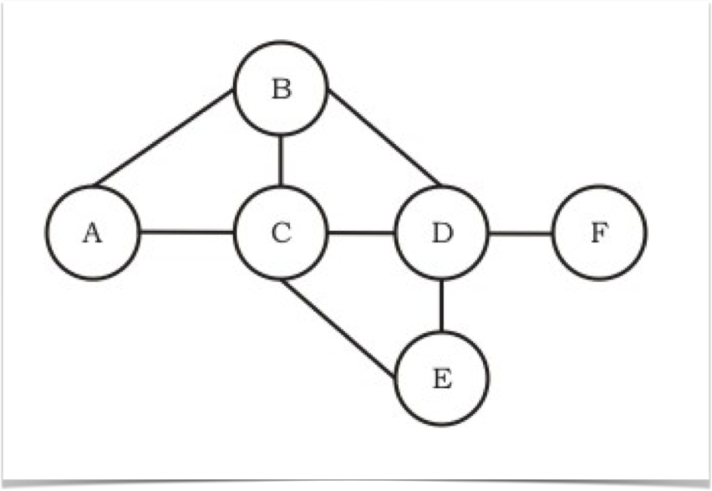
Dijkstra’s Algorithm
-an example
7
4
2
Implementation of Dijkstra’s Algorithm :
8
1
Graph
G = (Nodes, Edges)
3
6
2
Nodes /Routers
{A,B,C,D,E,F}
What is the Best
Path from
A to F ?
Edges /Links
{(A,B),(A,C),(B,C),(C,D),(B,D),(C,E),(D,E),(D,F)}

Slide 12
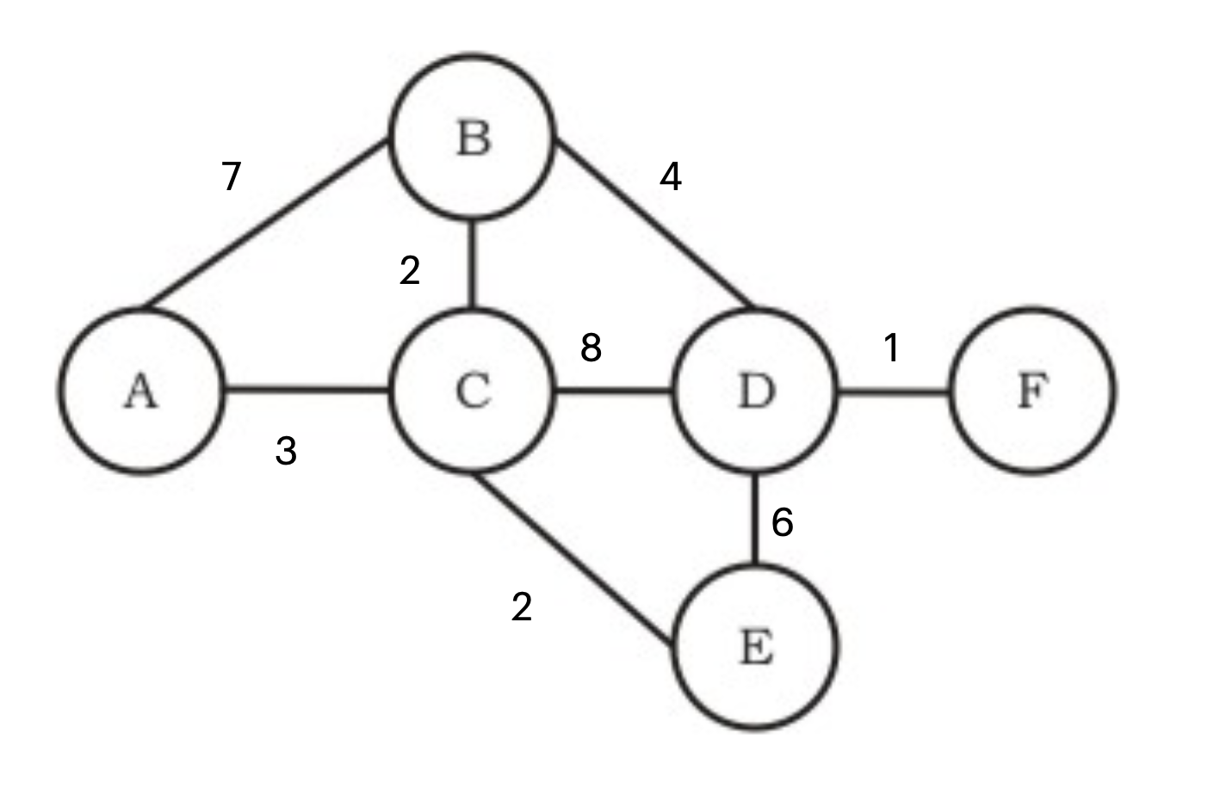
Step | Visited | D(B)P(B) | D(C)P(C) | D(D)P(D) | D(E)P(E) | D(F)P(F)
0 | A | 7,A | 3,A | ∞ | ∞ | ∞
7,A
3,A

Slide 13
Step | Visited | D(B)P(B) | D(C)P(C) | D(D)P(D) | D(E)P(E) | D(F)P(F)
0 | A | 7,A | 3,A | ∞ | ∞ | ∞
1 | AC | 5,C |  | 11,C | 5,C | ∞
5,C
7,A
11,C
3,A
5,C

Slide 14
Step | Visited | D(B)P(B) | D(C)P(C) | D(D)P(D) | D(E)P(E) | D(F)P(F)
0 | A | 7,A | 3,A | ∞ | ∞ | ∞
1 | AC | 5,C |  | 11,C | 5,C | ∞
2 | ACB |  |  | 9,B | 5,C | ∞
5,C
7,A
9,B
11,C
3,A
5,C

Slide 15
Step | Visited | D(B)P(B) | D(C)P(C) | D(D)P(D) | D(E)P(E) | D(F)P(F)
0 | A | 7,A | 3,A | ∞ | ∞ | ∞
1 | AC | 5,C |  | 11,C | 5,C | ∞
2 | ACB |  |  | 9,B | 5,C | ∞
3 | ACBE |  |  | 9,B |  | ∞
5,C
7,A
9,B
11,C
3,A
5,C

Slide 16
Step | Visited | D(B)P(B) | D(C)P(C) | D(D)P(D) | D(E)P(E) | D(F)P(F)
0 | A | 7,A | 3,A | ∞ | ∞ | ∞
1 | AC | 5,C |  | 11,C | 5,C | ∞
2 | ACB |  |  | 9,B | 5,C | ∞
3 | ACBE |  |  | 9,B |  | ∞
4 | ACBED |  |  |  |  | 10,D
5,C
7,A
9,B
11,C
10,D
3,A
5,C

Slide 17
Step | Visited | D(B)P(B) | D(C)P(C) | D(D)P(D) | D(E)P(E) | D(F)P(F)
0 | A | 7,A | 3,A | ∞ | ∞ | ∞
1 | AC | 5,C |  | 11,C | 5,C | ∞
2 | ACB |  |  | 9,B | 5,C | ∞
3 | ACBE |  |  | 9,B |  | ∞
4 | ACBED |  |  |  |  | 10,D
5 | ACBEDF
5,C
7,A
9,B
11,C
10,D
3,A
5,C

Slide 18

Now its time to understand
Flooding
Initial State
Final State
I know my
neighbors
I know the entire graph

Slide 19
Lets look at the flooding demo

Slide 20


Slide 21
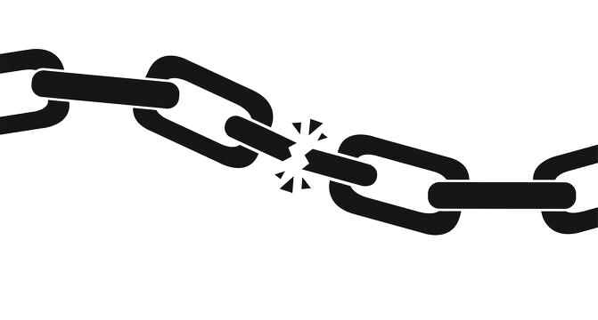
Link Breaking In Network
Link breakages are common in an network.
After a link breaks, flooding in network occurs
again and the routing tables are updated.

Slide 22
Example
7
4
2
Step | Island | D(B)P(B) | D(C)P(C) | D(D)P(D) | D(E)P(E) | D(F)P(F)
0 | A | 7,A | 3,A | ∞ | ∞ | ∞
1 | AC | 5,C |  | 11,C | 5,C | ∞
2 | ACB |  |  | 9,B | 5,C | ∞
3 | ACBE |  |  | 9,B |  | ∞
4 | ACBED |  |  |  |  | 10,D
5 | ACBEDF
8
1
3
6
2
A to F

Slide 23
Example
Oops, the link
broke!
7
4
2
Step | Island | D(B)P(B) | D(C)P(C) | D(D)P(D) | D(E)P(E) | D(F)P(F)
0 | A | 7,A | 3,A | ∞ | ∞ | ∞
1 | AC | 5,C |  | 11,C | 5,C | ∞
2 | ACB |  |  | 11,C | 5,C | ∞
3 | ACBE |  |  | 11,C |  | ∞
4 | ACBED |  |  |  |  | 12,D
5 | ACBEDF
8
1
3
6
2
Updated!
A to F

Slide 24
Lets look at our code
And its implemented features !

Slide 25









Router Class
Functions
fail_link()
_complete_global_view()
forward()
run()
receive()
_dijkstra_()
_get_shortest_path_()
_create_routing_table_()
received_fail_link()

